Slide 1
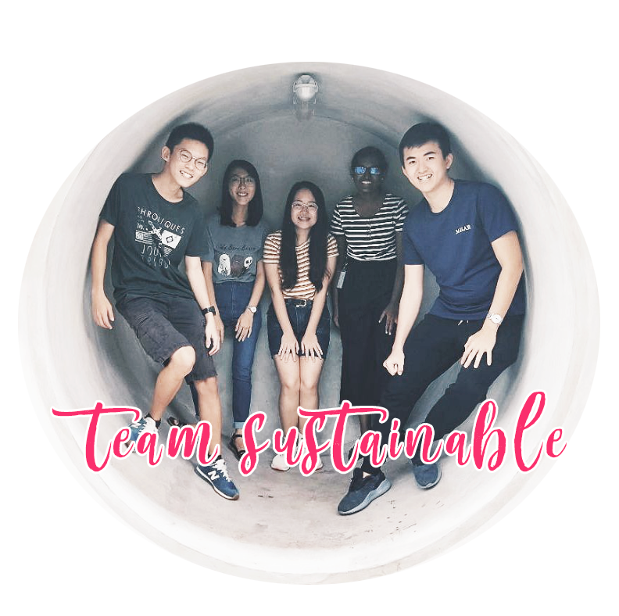

OBJECTIVE | PROBLEM | INSPIRATION | SOLUTION | FOLLOW-UP

Slide 2
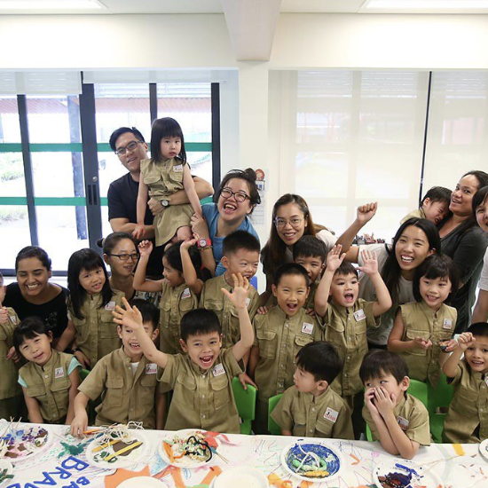
Objective
Make the learning experience safer for the preschoolers in enabling village as well as allow teachers to better handle the demands of taking care of both special needs and normal kids
OBJECTIVE | PROBLEM | INSPIRATION | SOLUTION | FOLLOW-UP

Slide 3
Observation
Part of the curriculum involves the kids to go on learning journeys around enabling village to learn more about nature and play.
During our learning trip, we observed that each class of about 15 preschoolers had roughly 2 teachers.
With the 70-30 ratio of normal and special needs kids in the classes, teachers might be overwhelmed and unable to look out for the safety of each child.
OBJECTIVE | PROBLEM | INSPIRATION | SOLUTION | FOLLOW-UP

Slide 4
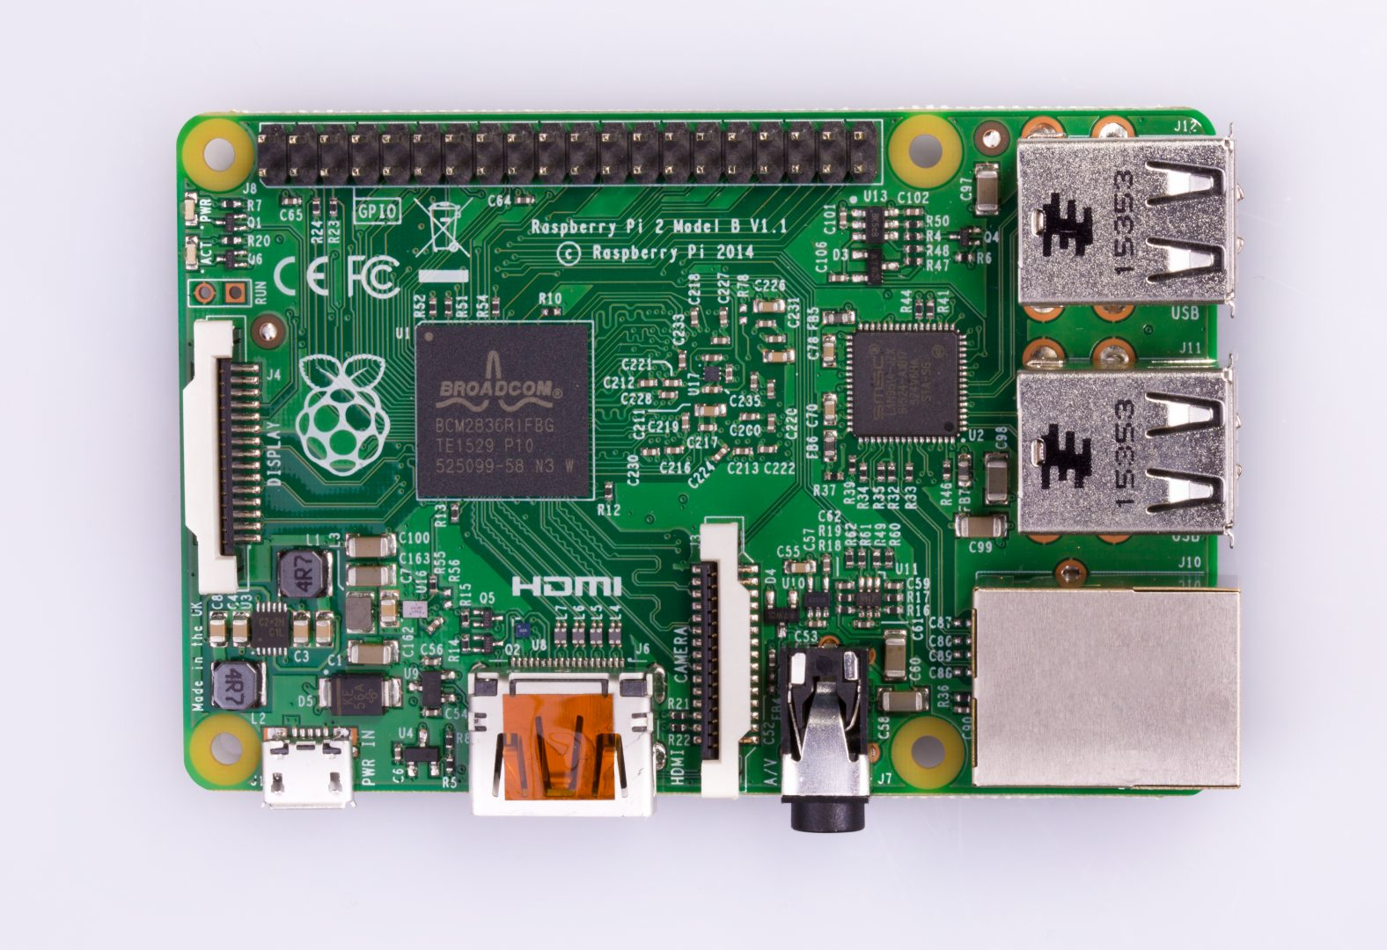
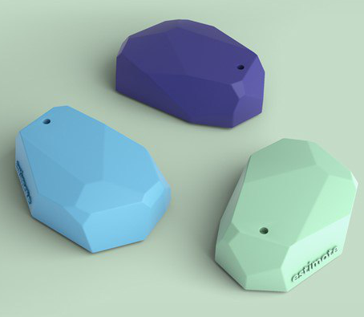
Inspiration
Raspberry Pi 2
Beacon
OBJECTIVE | PROBLEM | INSPIRATION | SOLUTION | FOLLOW-UP

Slide 5
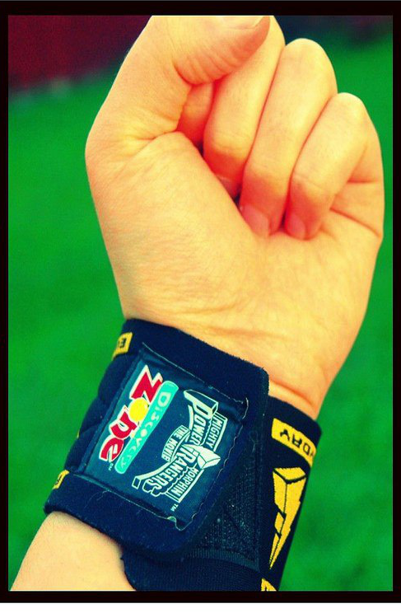
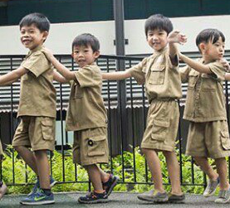

Inspiration
EV’s art faculty proj
Children’s wristband
EV’s safari uniform
OBJECTIVE | PROBLEM | INSPIRATION | SOLUTION | FOLLOW-UP

Slide 6
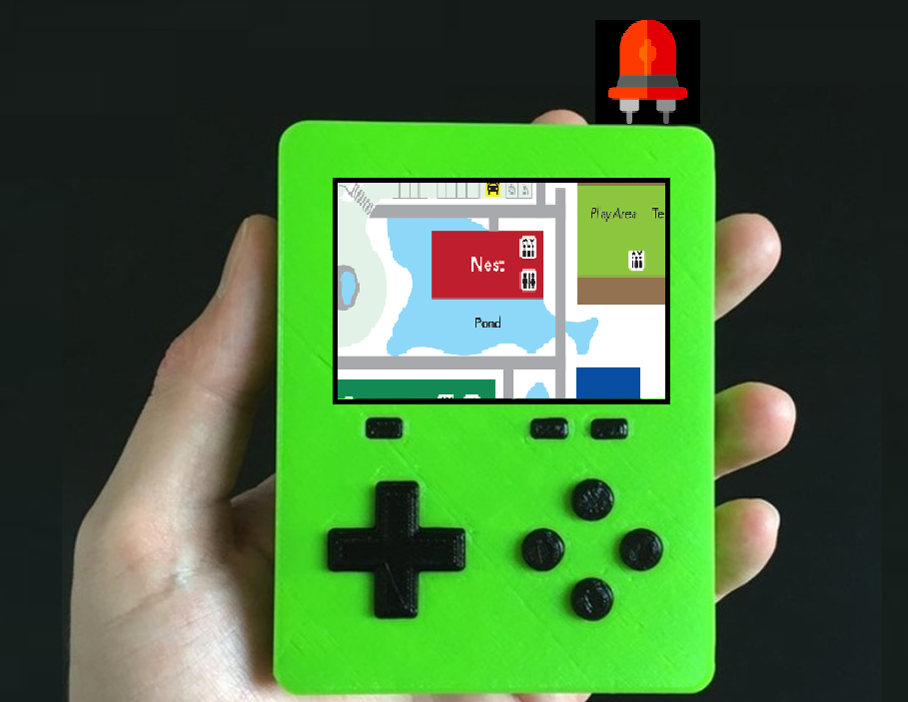
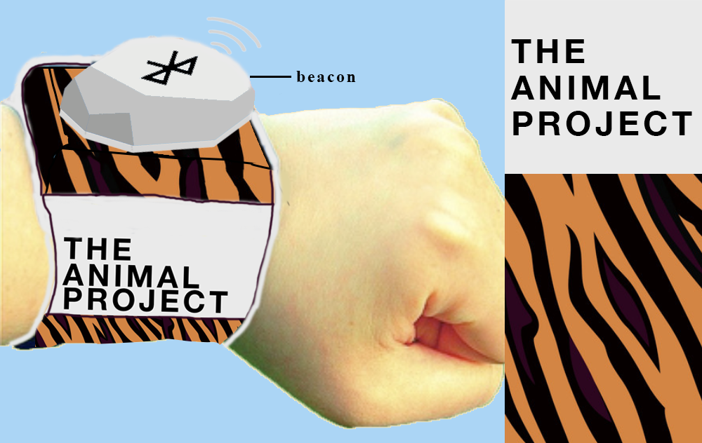


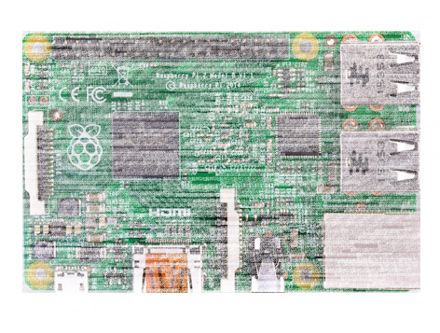
Solution
Raspberry Pi 2
Beacon
OBJECTIVE | PROBLEM | INSPIRATION | SOLUTION | FOLLOW-UP
Notes:
Wristband with a tracking beacon attached for every student
1 Raspberry Pi device held by teacher

Slide 7
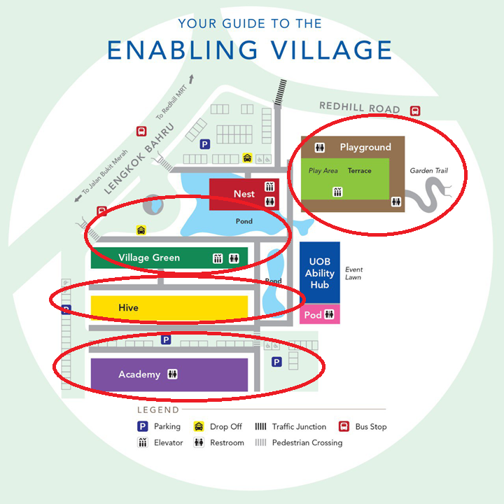
4 Raspberry Pi device set up around Enabling Village
Purple Zone
Yellow Zone
Green Zone
Brown Zone
OBJECTIVE | PROBLEM | INSPIRATION | SOLUTION | FOLLOW-UP

Slide 8

In-built website which shows the students’ location detected by 4 Raspberry Pi around Enabling Village
OBJECTIVE | PROBLEM | INSPIRATION | SOLUTION | FOLLOW-UP

Slide 9


Distance between child’s beacon and teacher’s raspberry pi
= OUT OF RANGE
Distance between child’s beacon and Brown Area raspberry pi
= WITHIN RANGE
Where is Bai (Student ID=9)?
Bai (Student ID=9) is at Brown Area
Rasberry Pi at Brown Area
Notes:
Tracking: ID of child, Last seen of child, Distance between child and teacher, Distance between child and raspberry pi in X area

Slide 10
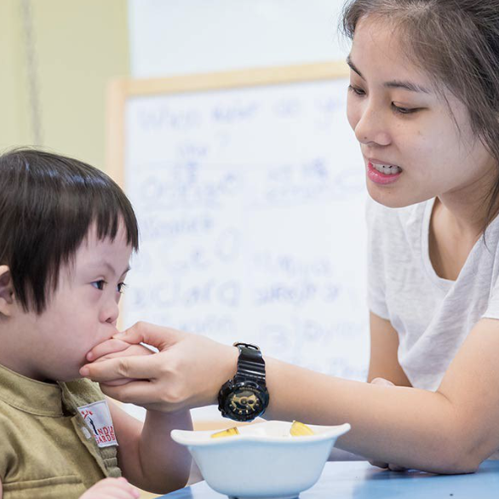
Scenario
Students are required to put on the wristband as part of their uniform
Wristbands have to be turned on at all times during the class.
OBJECTIVE | PROBLEM | INSPIRATION | SOLUTION | FOLLOW-UP

Slide 11
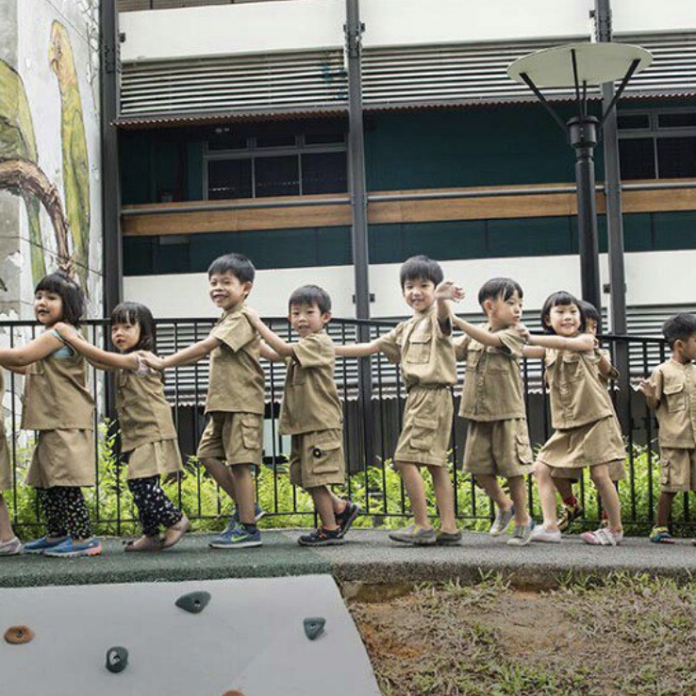
Scenario
The class plans to head to the Enabling Village pond for a learning journey. Main teacher-in-charge, Miss Tan has a handheld device which keeps track of the student's location through the wristbands.
Suddenly, the device's LED turns on with a siren sound.
OBJECTIVE | PROBLEM | INSPIRATION | SOLUTION | FOLLOW-UP
Notes:
Meaning that one or more of the wristbands are further than the range set between their beacons and the teacher’s raspberry pi.

Slide 12
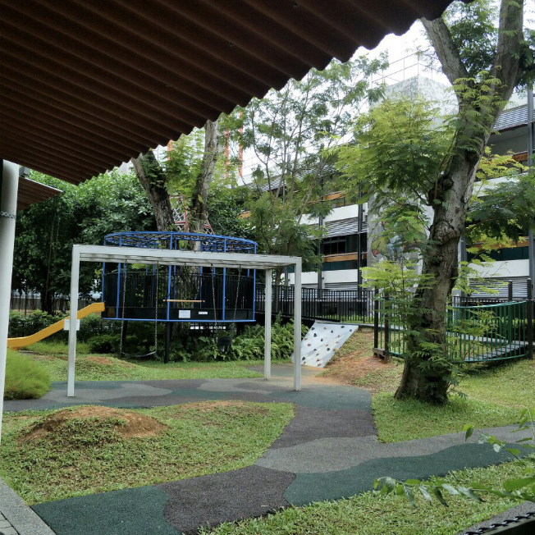
Scenario
Teachers gather all the students again to do a head count.
Student Vinnie is missing, Miss.Tan immediately connects to the webpage to check the location the student.
The webpage will show the last seen location of the student, which Is in the brown area
OBJECTIVE | PROBLEM | INSPIRATION | SOLUTION | FOLLOW-UP
Notes:
Miss Tan knows the id of the student? And inputs it in the web url?

Slide 13
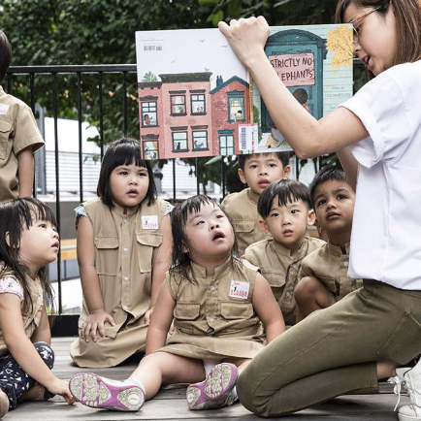
Scenario
The other teacher IC, Miss LIm brings everyone back to the classroom, while Miss Tan heads to the last seen location to search for poor Bai. Miss Tan constantly checks the webpage for the last seen location to narrow the searching area. With not much difficulty, Bai was found at the gate of the playground. The class had a good lesson on how to stay together and not get lost!
OBJECTIVE | PROBLEM | INSPIRATION | SOLUTION | FOLLOW-UP

Slide 14

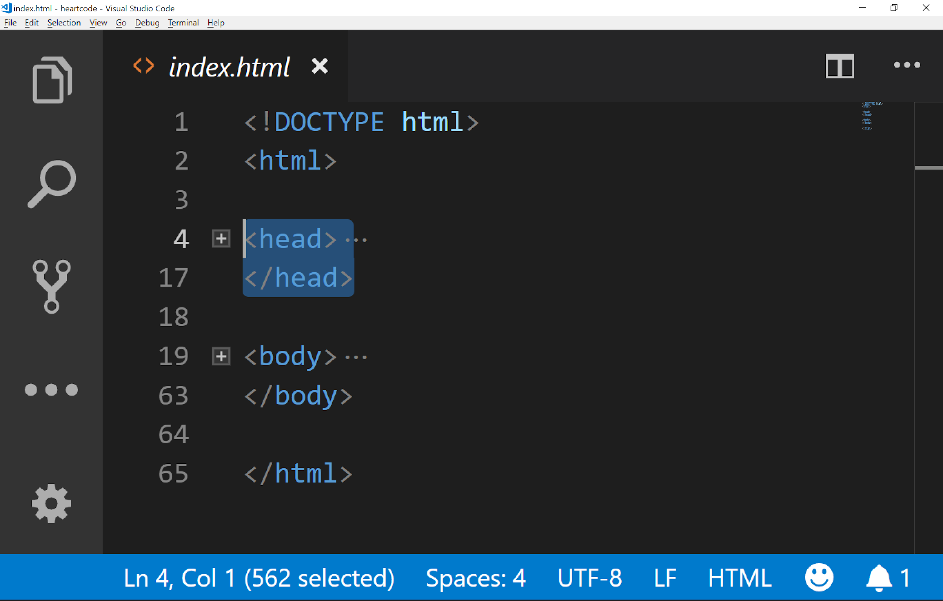

Follow-up Actions
Revisit EV to test feasibility
Revision of training sessions as a team
Code out a full-functioning web application of our idea
OBJECTIVE | PROBLEM | INSPIRATION | SOLUTION | FOLLOW-UP

Slide 15
Thank You
Notes:
With that, thank you and moving on the Q&A time

